Slide 1

Green Pace
Security Policy Presentation
Developer: Kimberly Blackwood

Slide 2
OVERVIEW
As a developer I have been tasked with presenting a brand-new security policy to the whole development team for Green Pace. My presentation contains policies, standards, principles, and best practices that help prevent the threat of potential security vulnerabilities in both code development and systems architecture. ( will present the Green Pace security guide, along with implementation and maintenance guidelines.
I will translate our informal, day-to-day practices into official procedures focusing on the attack surface and vulnerability assumptions.
Defense In Depth - instead of depending on a single security perimeter, Defense In Depth is a layered security approach that ensures
Notes:
I

Slide 3

OVERVIEW: DEFENSE IN DEPTH
What is Defense In Depth?
Defense In Depth Is not depending on a single security perimeter. It is a layered security approach that ensures that one compromised point does not grant total access to the entire network. The diagram below shows the different layers of security that is provided when Defense In Depth is applied.
Defense In Depth - instead of depending on a single security perimeter, Defense In Depth is a layered security approach that ensures
Notes:
I

Slide 4
THREATS MATRIX
Threats ,the show matrix. This is what we use to access security risk and how important or frequent are the potential threats to our system. We can see in the upper left we have threats that are likely, they have a high chance to cause a potential exploit., in the upper right we have the priority threats, likely and high severity with a low cost of repsair. In the lower left we have low priority, low severity with a high cost if exploited. Finally, we have the threats that are unlikely, not likely to cause a potential exploit.
Likely here. STD-003-CPP STD-005-CPP | Priority STD-001-CPP STD-002-CPP STD-004-CPP STD-009-CPP STD-010-CPP
Low priority STD-007-CPP | Unlikely STD-006-CPP STD-008-CPP

Slide 5
10 PRINCIPLES
Now we will talk about the 10 principles:
Validate input data – you should never trust outside data.
Obey compiler warnings – enable all compiler warnings and heed to them.
Architect and design for security policies – by dividing the system into distinct, privilege specific subsystems the software architecture enforces security policies.
Keep it simple – it is important to keep design simple and concise.
Default deny – by default there is no access unless you specify that there is access.
Adhere to the principle of least privilege – every process should run with the minimum privileges required to perform its function.
Sanitize data sent to other systems – always sanitize data before directing it to complex subsystems such as databases and command shells.
Practice Defense in Depth - reduce risk through Defense In Depth.
Use effective quality assurance techniques – effective quality assurance procedures are critical for locating and removing vu;neralbilities.
Adapt a secure coding standard – apply and follow a secure coding standard.

Slide 6
CODING STANDARDS
We will now look at the oding standards in my security policy.
1.Range verification –avoid index errors and out of bounds
2.No Args C-Style functions – always check the arguments passed
3.Overflow Prevention – ensure that assignment fit in the buffer.
4.Explicit code – the more explicit the better.
5.Unsafe memory access – prevent things as dereferencig pointers
6.Improper assertions – use the correct assertions
7.Robust exception handling – catch exceptions properly
8.Variable shadowing – must be avoided
9.Proper resource management - all files must be properly closed
10.Single responsibility code – separate functionality
Range ne definition rule(ODR). Prevents unintentional data truncation, overflow, and ambiguity that can lead to bugs or security vulnerabilities One definition rule(ODR). Prevents unintentional data truncation, overflow, and ambiguity that can lead to bugs or security vulnerabilities 8.8.

Slide 7
ENCRYPTION POLICIES
We will now speak about the three encryption policies:
Encryption at rest protects data that is stored on a device. This includes smartphones, and hard drive. Authorized users and applications easily decrypt data immediately when access is required , given that correct encryption key is produce. This policy applies because it is a foundational part of defense in depth and enforce regulatory compliance.
Encryption in flight, protects data that is moving. This ca be between clients, services, and network. It is designed to prevent spying, tampering and message forgery on client server links. The policy applies because it ensures that the data that is received is what was sent, compliance with privacy regulations and prevents man in the middle.
Encryption in use, protects data that is actively being processed by a computer system. It applies by enforcing confidentiality. It stops threats by preventing them from stealing useable information from active memory

Slide 8
TRIPLE-A POLICIES
Policies that support authentication, authorization, and accounting will now be explained.
Authentication - verifies the user’s identity by use of phishing resistant Multi-Factor-Authentication(MFA). It stops hackers from getting access to the network by limiting access. A user logs in their VPN using their username and MFA token.
Authorization – dictates what resources an authenticated user has access to view or modify. A least privilege approach is required by best practices
Accounting – tracks and logs user activity and system changes. Abnormal behaviors will be caught by continuous monitoring and detailed auditing.

Slide 9
Unit Testing
Unit testing is a software testing method used to verify the functionality of individual components or modules of a program. It ensures that each unit performs correctly in isolation before integration into the complete system.
I created a full range of positive and negative tests The output showed a successful C++unit test ran. My CollectionTest suite executed 15 tests and passed all of them. This means that my custom collection or vector implementation is working exactly as intended without any errors.

Slide 10
Unit Testing
A quick breakdown of the results:
Total Tests: 15
Passed: 15
Failed: 0
Total Time: 0 ms (executed instantly)
Tested Features: Basic initialization, adding/erasing items, vector resizing, capacity tracking, and out-of-range safety check

Slide 11
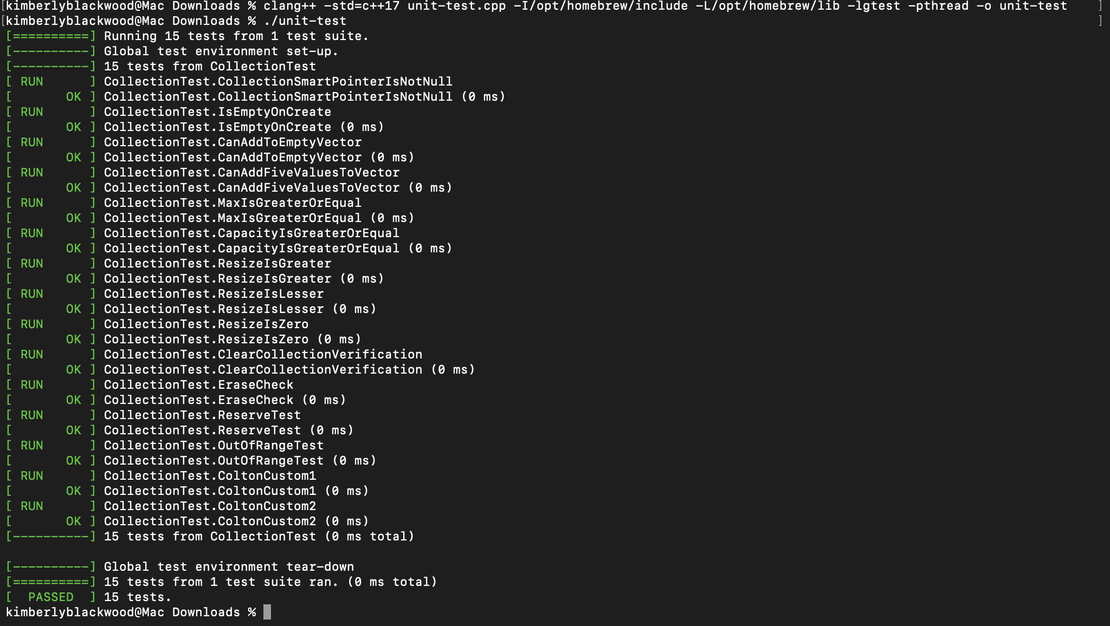
Unit Testing
l

Slide 12

AUTOMATION SUMMARY

Slide 13
TOOLS
DevSecOps pipeline is a method used to enforce code security by building and writing efficient code in a full circle. To enforce DevSecOps we can use several external tools. These include monitoring services(log rocket). We could also add automated tools such as integration testing to ensure that we are meeting the standards and best practices.
DevOps becomes DevSecOps after the security measure of each step of the DevOps toolchain is combined. Threat modelling is addressed in the Access and Plan phase, while IDE security is managed during the Design and Build phase. The verify and test phase has automated security scans and static code analysis, expanding the testing suite beyond unit and integration testing.
After deployment, automated pipelines keep the integrity of the system and defense in depth to prevent vulnerabilities. Constant threat detection relies on performance logs, network monitoring, and ongoing penetration testing. Security practices such as standard QA, needs to be in place early and often in the development process.

Slide 14
RISKS AND BENEFITS
When working with software and systems there are always risk. A lot of the risk can be reduced by following the standard procedures, implementing Defense In Depth, Triple A and best practices. These reduce the risk of security threats immensely.
A benefit iis, “Don’t lleave security to the end ” means integrating security throughout the Software Development Life Cycle(SDLC). Security experts should be involved in every phase of the architecture and design process. We should never treat security as a final checklist-item, this will lead to hackers having access to the software which will be disastrous for companies(Ryther.J).

Slide 15
RECOMMENDATIONS
I recommend encryption of data when necessary, applying the Principle of Least Privilege, scan for software vulnerabilities frequently and keeping dependencies up to date to fix all the gaps in the security policy.
I plan to ensure that security is addressed intrinsically and not lefave it until an issue is discovered in my project by implementing the use of integration testing.
Integration testing is the process in which the interface of different applications, modules or components of a software application are tested as a combined group. This testing shows the testing team how well diverse elements work together.
Integration testing provides several advantages, which includes:
Detecting integration issues early by identifying and rectifying issues when different components or modules of the software interact.
Cost effective and time saving , by early detection and resolution of integration issues developers save both time and money.
Enhance software readability, by verifying that different parts of the application work well together.
Customer satisfaction, when the software is reliable and error-free it leads to higher customer satisfaction(Masquita.H,2025)

Slide 16
CONCLUSION
This presentation provides outlined security specifications that can be implemented to prevent security threats. Security must be put in place at all stages of the Software Development Life Cycle (SDLC). As developers we must work as a team to ensure that we apply best practices on all software systems. Standardizing these rules ensures that security remains everyone's priority as Green Pace grows. Thank you, and I am happy to open the floor to any questions.

Slide 17
REFERENCES
Masquita.H.( 2025). Medium.The Importance of Integration Test in Software Development. https://medium.com/@higor.mesquita/the-importance-of-integration-tests-in-software-development-44cc88c8da4e
One Identity.(2026) .he best Identity Governance for Healthcare IdentutyManagement.https://www.oneidentity
Ryther.J.(2022).Medium. Don’t Leave Security to The End.https://medium.com/@jryther91/dont-leave-security-to-the-end-ca13b107d4

